Slide 1

School Infrastructure Analysis Dashboard (2018–19)
Analysis of Educational Infrastructure Across Indian States
Name – Harsh Mehta

Slide 2
PROJECT OVERVIEW
This dashboard presentation analyzes different aspects of educational infrastructure and literacy performance across Indian states using multiple datasets. The presentation includes analysis of electricity availability in schools, enrollment ratios of children with disabilities, literacy rate comparisons, sanitation and hygiene facilities, accessibility infrastructure, and digital education resources. Various chart types and visualizations have been used to highlight key insights, comparisons, and infrastructure trends across different regions of India.
Presentation Flow
Electricity Analysis
Literacy Rate Comparison
Enrollment Ratio Analysis
Accessibility Infrastructure Analysis
Hygiene & Sanitation Analysis
Final Dashboard
Conclusion

Slide 3
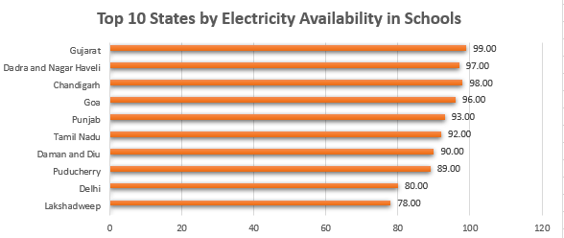
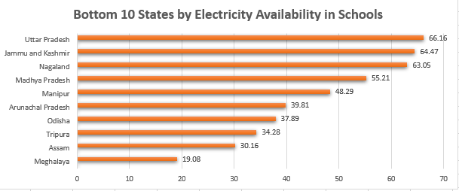
ELECTRICITY ANALYSIS
Top 10 States by Electricity Availability
This chart represents the top 10 Indian states with the highest electricity availability in schools during 2018–19 Gujarat achieved the highest electricity access, highlighting strong educational infrastructure development across several states.
Bottom 10 States by Electricity Availability
This chart represents the bottom 10 Indian states with the lowest electricity availability in schools during 2018–19. Meghalaya recorded the lowest electricity access, highlighting infrastructure challenges in several regions of India.

Slide 4
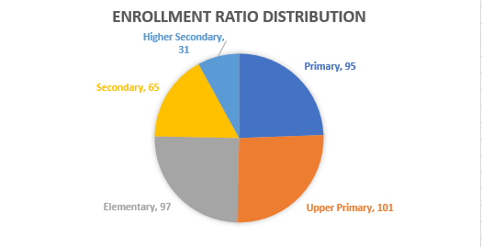
ENROLLMENT RATIO ANALYSIS
This pie chart represents the distribution of enrollment ratios of children with disabilities across different education levels during 2018–19. The analysis shows that Upper Primary and Elementary levels recorded higher enrollment ratios, while Higher Secondary had the lowest enrollment ratio, highlighting a decline in participation at advanced education levels.

Slide 5
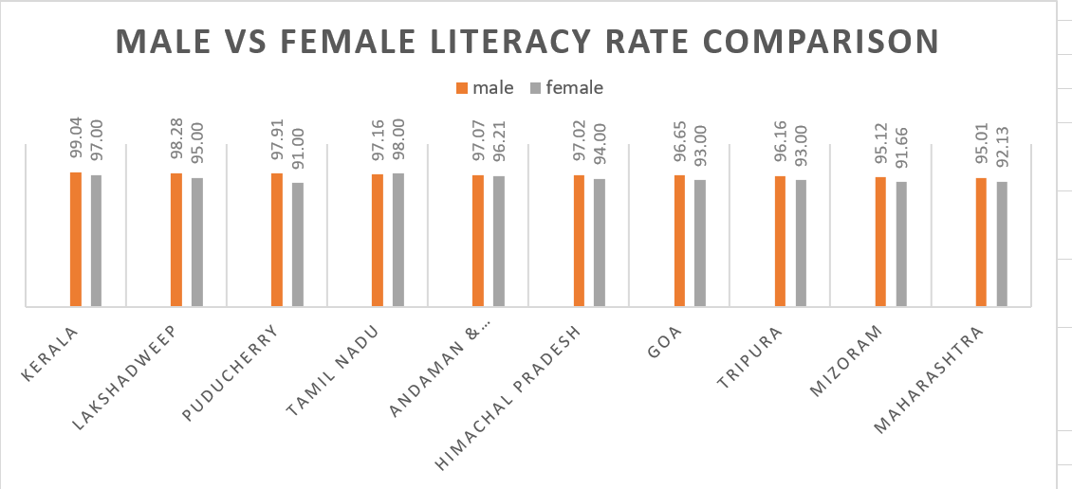
LITERACY RATE COMPARISON
This chart represents the comparison between male and female literacy rates across selected Indian states during 2019.The analysis shows that male literacy rates are slightly higher than female literacy rates in most states. Kerala recorded the highest literacy performance, while other states also demonstrated strong educational development and literacy awareness.

Slide 6
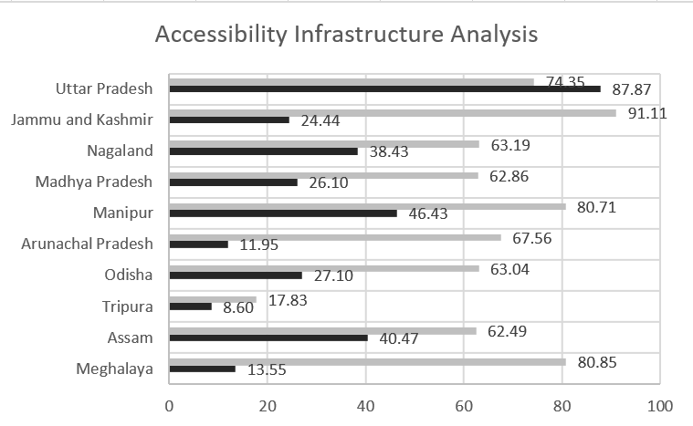
Accessibility Infrastructure Analysis
This chart represents the comparison between disabled-friendly toilet facilities and ramp availability in schools across selected Indian states during 2018–19. The analysis shows that ramp availability is significantly higher than disabled-friendly toilet facilities in many states, highlighting gaps in accessibility infrastructure and inclusive educational support across different regions of India.

Slide 7
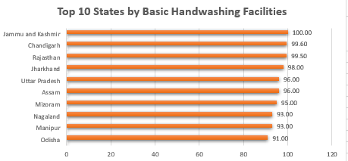
This chart represents the top 10 Indian states with the highest availability of basic handwashing facilities in schools during 2018–19. The analysis shows that Jammu and Kashmir recorded the highest percentage of handwashing facilities, followed closely by Rajasthan and Chandigarh. The chart highlights strong progress in school hygiene infrastructure and sanitation facilities across several Indian states.
HANDWASHING FACILITIES ANALYSIS

Slide 8
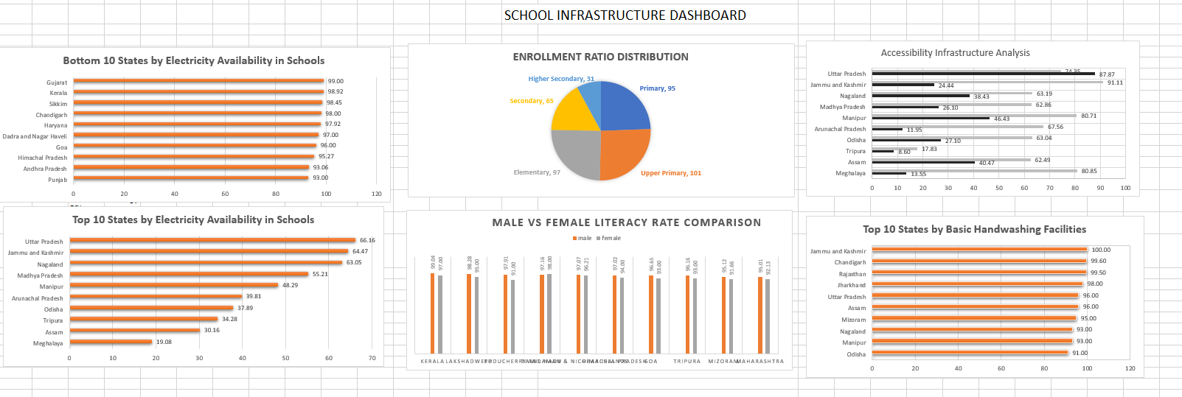

Slide 9

This Photo by Unknown Author is licensed under CC BY-SA

